Slide 1
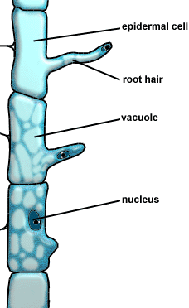
Simple permanent tissue
vi. Surface tissue :
Epidermal cells of the roots, whose function is water absorption, commonly bear long hair-like parts that greatly increase the total absorptive surface area.

Slide 2
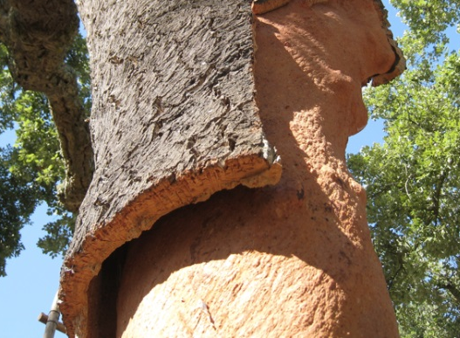
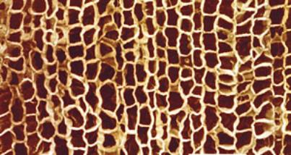
Simple permanent tissue
vi. Surface tissue :
As woody plants grows older the outer protective surface tissue undergoes certain changes.
This forms the several layer thick cork or bark of the tree.
Cells of the cork are dead and are compactly arranged without intercellular spaces.
They also have a chemical called suberin on their walls that makes them impermeable to gases and water.
Cork
A waxy substance
Which does not permit

